Slide 1

LINEAR ALGEBRA AND ITS APPLICATIONS PROJECT COURSE CODE : UE20MA251 OUR TOPIC : IMPLEMENTATION OF IMAGE STEGANOGRAPHY USING PYTHON
TEAM DETAILS:
NAME SRN
AISHWARYA PARTHASARATHI PES1UG20CS523
ALMAS BANU PES1UG20CS535
ANUSHA Y ACHAR PES1UG20CS539
BRINDA N PES1UG20CS542

Slide 2
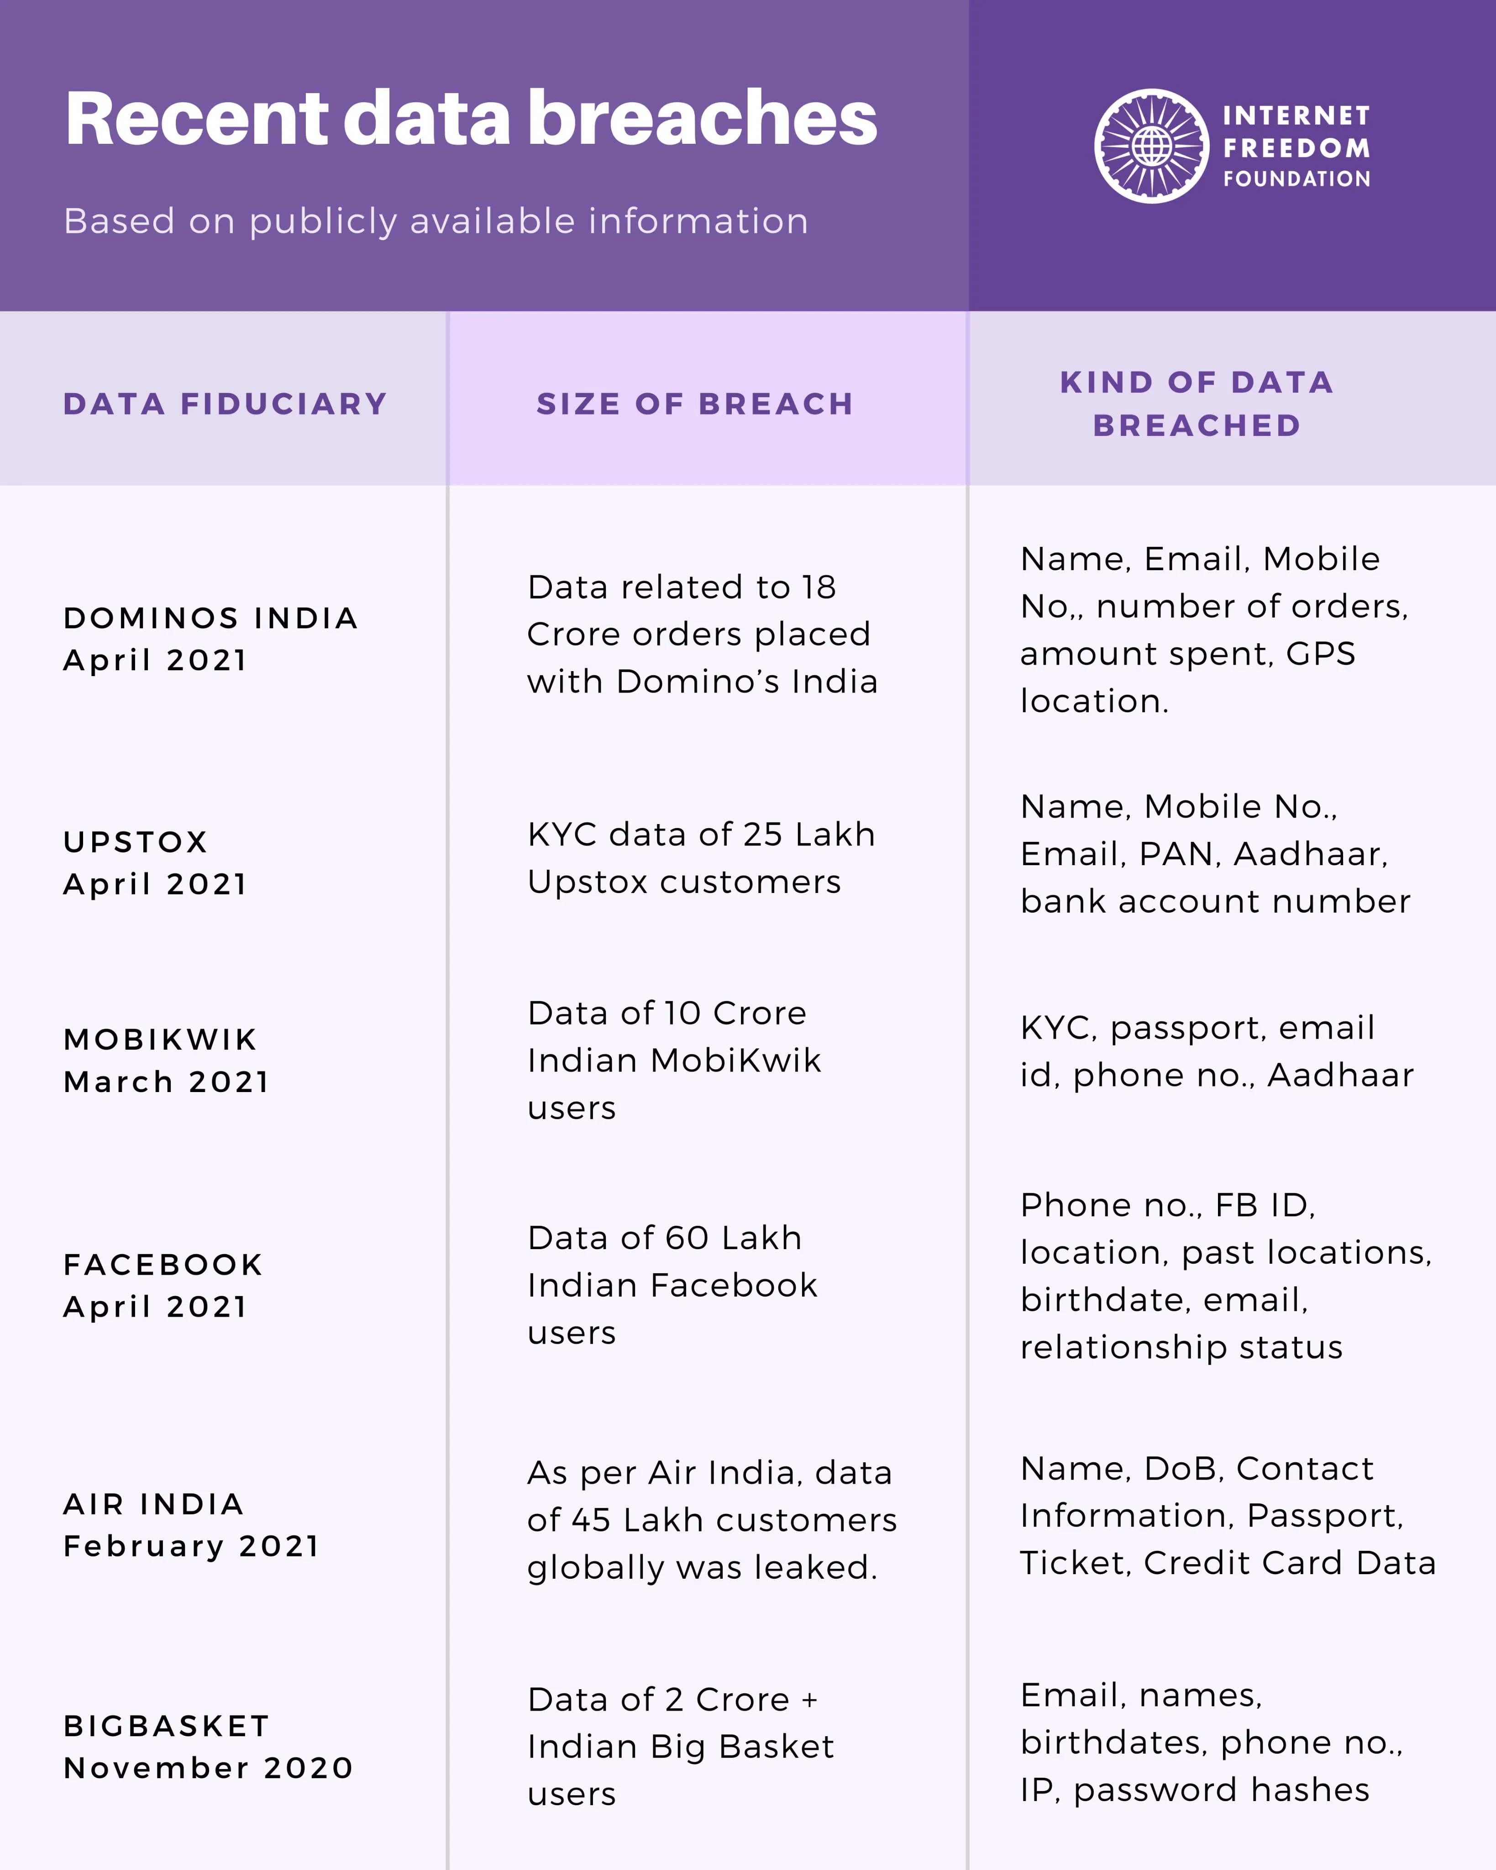
WHY IS DATA SECURITY IMPORTANT? Data security is the practice of protecting digital information from manipulation and unauthorized access during its entire lifecycle. In an increasingly interconnected environment, information is exposed to a growing number and wider variety of risks. Cybersecurity Ventures predicts that cyber crime will create damages of around $10.5 trillion annually by 2025. A 2018 InsuranceBee survey of small business owners shows that 54% of small businesses don’t have a plan in place to thwart cyber attacks. This lack of preparedness, along with other industry factors, means individuals with the right computer education and experience have ample opportunities to make a tangible impact in the battle against cyber crime.

Slide 3
STEGANOGRAPHY
Steganography ("covered writing") is the science of hiding information "in plain sight".
Steganography is the process of hiding a secret message within a larger one in such a way that someone can not know the presence or contents of the hidden message.
The purpose of Steganography is to maintain secret communication between two parties.
Steganography is the art of hiding a message or data in the form of text, image or multimedia into an image such that it can’t be detectable by naked eyes.

Slide 4
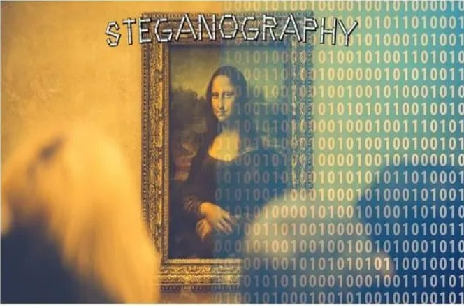
Significance of steganography
Steganography provides us with:
(A) Potential capability to hide the existence of confidential data
(B) Hardness of detecting the hidden (i.e., embedded) data
(C) Enhancing the secrecy of the encrypted data

Slide 5
ABSTRACT
Steganography is the dark cousin of cryptography, the use of codes. While cryptography provides privacy, steganography is intended to provide secrecy.
Steganography is a method of covertly communicating. Steganography is a process that involves hiding a message in an appropriate carrier for example an image or an audio file.
The carrier can then be sent to a receiver without anyone else knowing that it contains a hidden message. This is a process, which can be used forexample by civil rights organizations in repressive states to communicate their message to the outside world without their own government being aware of it.
Steganalysis is a newly emerging branch of data processing that seeks the identification of steganographic covers, and if possible message extraction. It is similar to cryptanalysis in cryptography. The technique is ancient emerging monster that have gained immutable notice as it have newly penetrated the world of digital communication security.
Objective is not only to prevent the message being read but also to hide its existence.

Slide 6
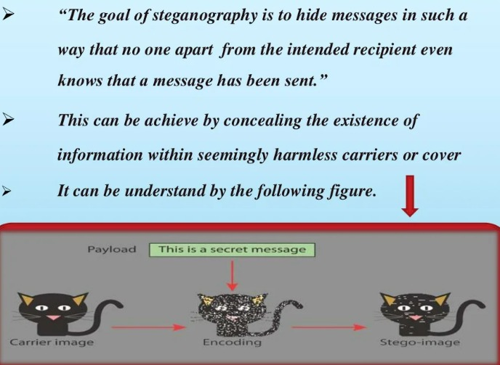
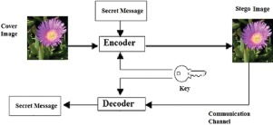

Slide 7
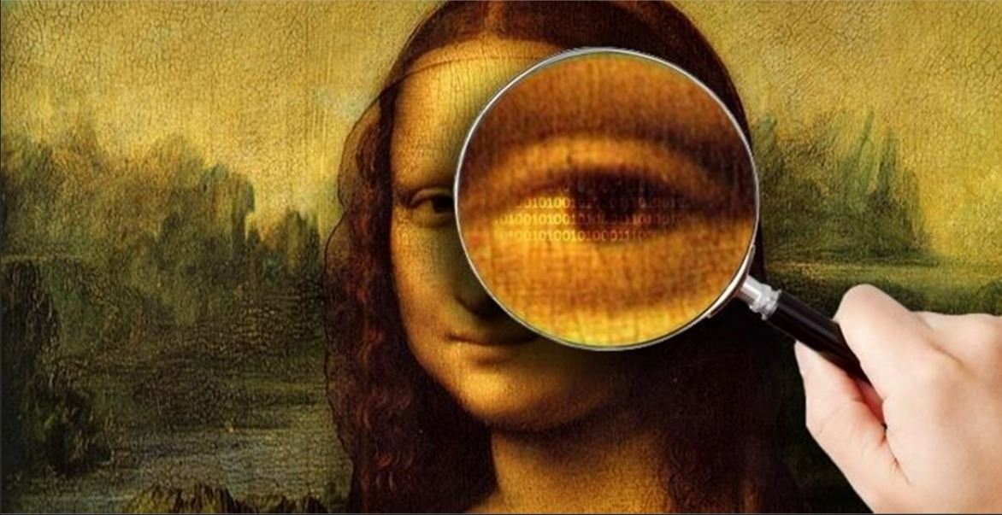
ABOUT THE PROJECT
This project introduces a new methodology for hiding a text data into an rgb image. The proposed technique can encode any color image files in order to protect confidential text data from unauthorized access.
Programming Language used is Python
Modules used are numpy,cv2 and types.

Slide 8
HISTORY OF STEGANOGRAPHY
A historic usage of steganography was pioneered by Histaeius of Milan to allow him to communicate secretly with the Greeks. Histaeius would shave the head of a slave, tattoo a message on the slave's scalp, and then wait for the hair to grow back, concealing the message. The slave would then be sent to the Greeks, who would shave the slave's head and read the hidden message.
Early
In ancient Greece, wax tablets with a wooden backing were common writing surfaces since the wax could be melted and reused. To send secret messages, a message would be inscribed directly on a wooden tablet before the wax was applied. Another, innocuous message would be carved into the wax on top and the tablet sent to its intended recipient, who would melt off the wax and read the true message. Another method of concealing messages was to encode a message on a piece of thread using Morse code. This thread would be knitted into the clothing of a messenger and then removed and read at its destination.

Slide 9
Wartime
During the World Wars, many different methods of sending hidden messages were used. Female spies would encode messages in knitted patterns (leading to a ban on new knitting patterns). Photosensitive glass (which shows an image when exposed to the correct wavelength of light) was used during World War II to send messages to Allied forces.
Modern
The most common form of steganography used today hides files within image files on a computer. The hidden file is encoded in the least significant bits of the values encoding the color of each pixel of the image. Changing the least significant bits changes the appearance of the image very slightly, and is not perceptible to the naked eye. If the change is detectable at all, the colors will just look a little off as if the image was taken from a low quality camera on in poor light. A similar process can be used to conceal data in sound files since the human ear is limited in its ability to differentiate different, similar frequencies (and in the range of frequencies it can detect).

Slide 10
Steganography Tools
Xiao Steganography
SSuite Picsel
Steghide
OpenPuff
Camouflage
Netcross
The steganographic process uses various digital objects as the carrier signals such as image, text, DNA, video, audio, and text, etc. Due to the property of innocence of digital images, researchers have preferred images as the carrier signal for hiding secret information. Also, the presence of redundant pixels in an image makes it even more suitable for embedding secret information. Hiding confidential information inside the image is known as image steganography.

Slide 11
METHOD
The most widely used technique today is hiding of secret messages into a digital image. This steganography technique exploits the weakness of the human visual system (HVS). HVS cannot detect the variation in luminance of color vectors at collection of color pixels. The individual pixels can be represented by their optical higher frequency side of the visual spectrum. A picture can be represented by a characteristics like 'brightness', 'chroma' etc. Each of these characteristics can be digitally expressed in terms of 1s and 0s. For example: a 24-bit bitmap will have 8 bits, representing each of the three color values (red, green, and blue) at each pixel. If we consider just the blue there will be 2 different values of blue. The difference between 11111111 and 11111110 in the value for blue intensity is likely to be undetectable by the human eye. Hence, if the terminal recipient of the data is nothing but human visual system (HVS) then the Least Significant Bit (LSB) can be used for something else other than color information.

Slide 12
LSB TECHNIQUE
The simplest approach to hiding data within an image file is called least significant bit (LSB) insertion. In this method, we can take the binary representation of the hidden data and overwrite the LSB of each byte within the cover image. If we are using 24-bit color, the amount of change will be minimal and indiscernible to the human eye. As an example, suppose that we have three adjacent pixels (nine bytes) with the following RGB encoding:
10010101 00001101 11001001
10010110 00001111 11001010
10011111 00010000 11001011
Now suppose we want to "hide" the following 9 bits of data (the hidden data is usually compressed prior to being hidden): 101101101. If we overlay these 9 bits over the LSB of the 9 bytes above, we get the following:
10010101 00001100 11001001
10010111 00001110 11001011
10011111 00010000 11001011

Slide 13
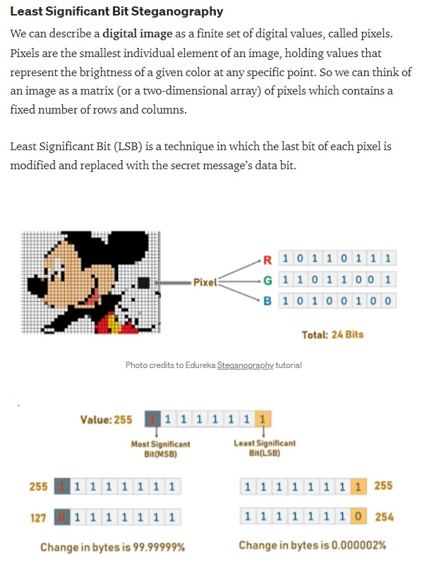
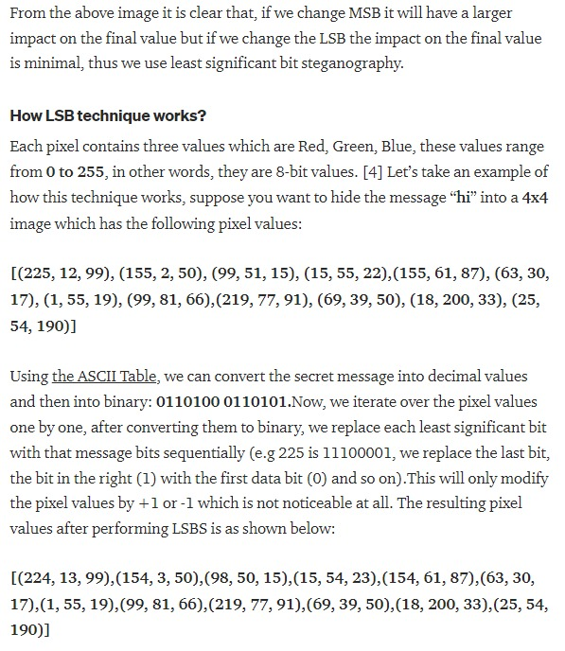

Slide 14
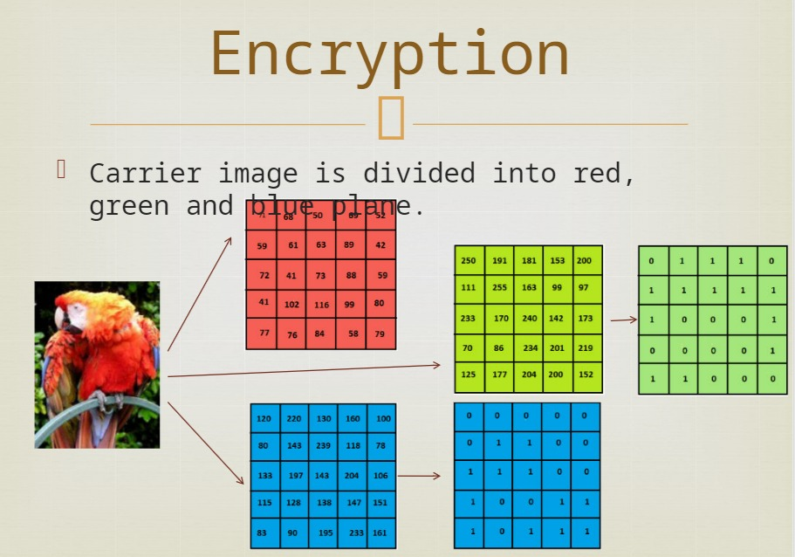
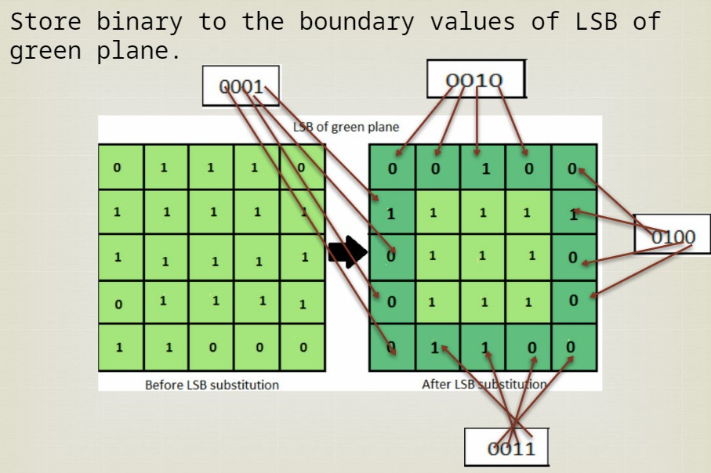

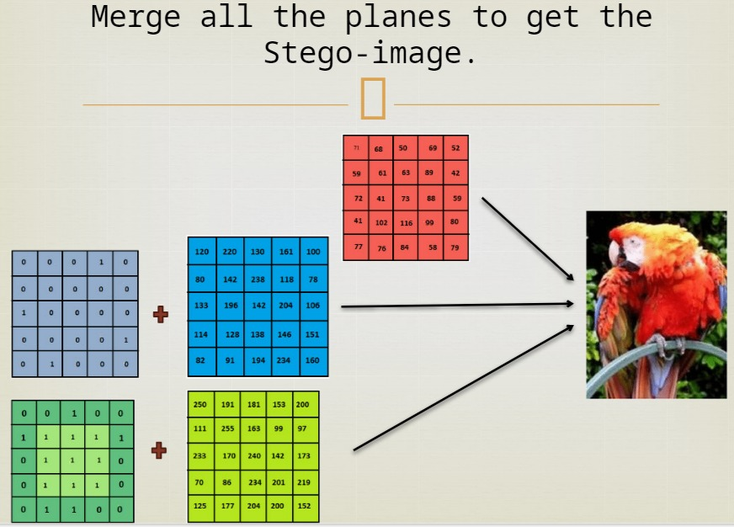
ENCRYPTION flowchart

Slide 15
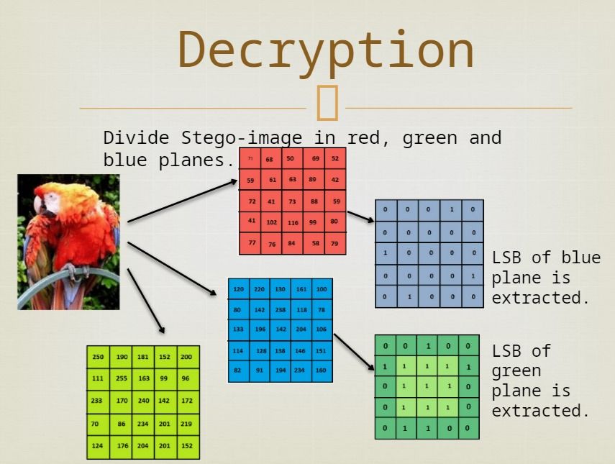
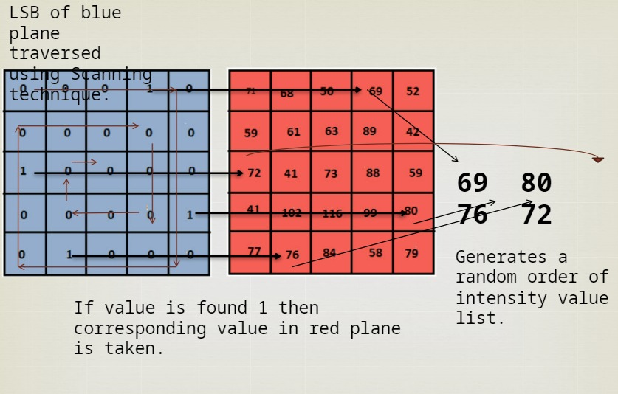
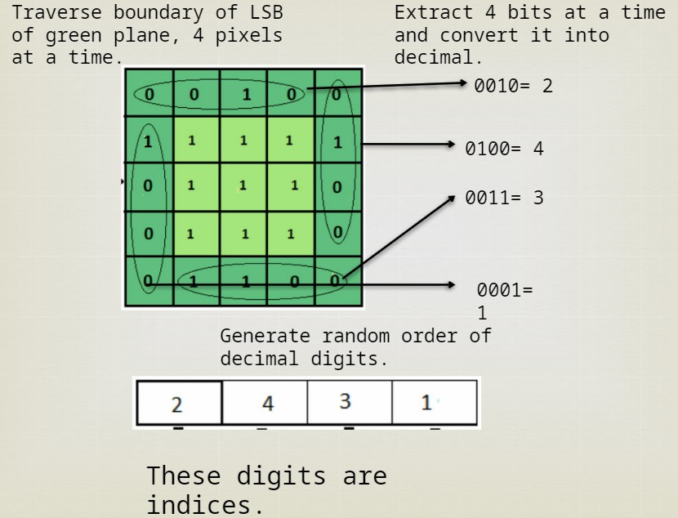
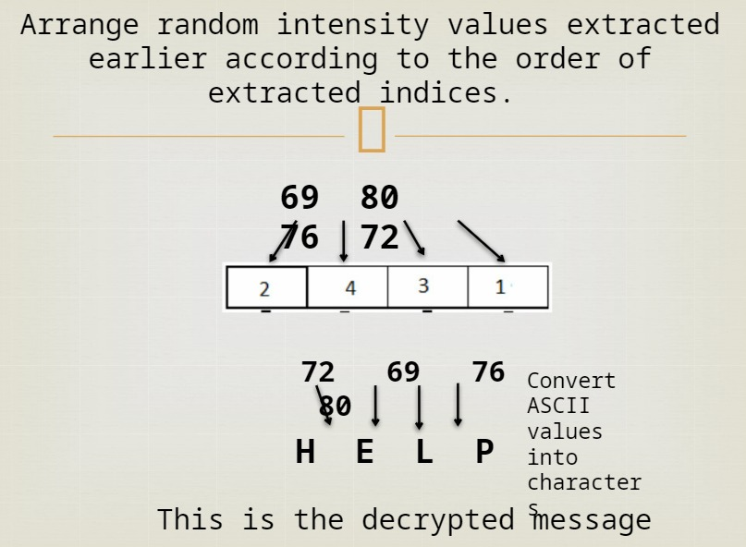
DECRYPTION flowchart

Slide 16
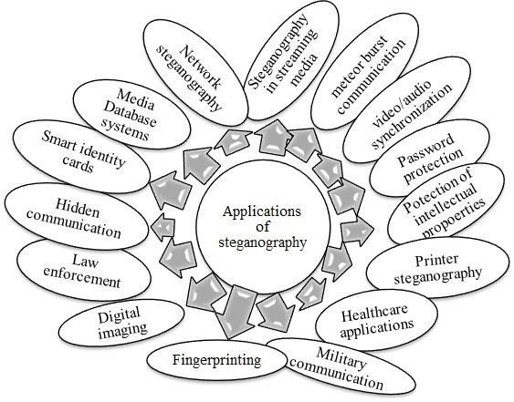
ADVANTAGES
The output image has very slight difference to the input image.
Instead of embedding the message in only the LSB, we can embed the message in last two LSBs ,thus embedding even larger messages.
This method forms the basics of many other complex algorithms.
No one suspects existence of messageHighly secure.
Difficult to detect and Only receiver can detect.

Slide 17
DIFFERENCE BETWEEN CRYPTOGRAPHY AND STEGANOGRAPHY
Cryptography and steganography are both methods used to hide or protect secret data. However, they differ in the respect that cryptography makes the data unreadable, or hides the meaning of the data, while steganography hides the existence of the data.
Steganography provides only confidentiality and authentication. On the contrary, the principles of security provided by the cryptography are confidentiality, integrity, authentication, and non-repudiation.
The steganography can be employed on any medium such as text, audio, video and image while cryptography is implemented only on the text file.

Slide 18
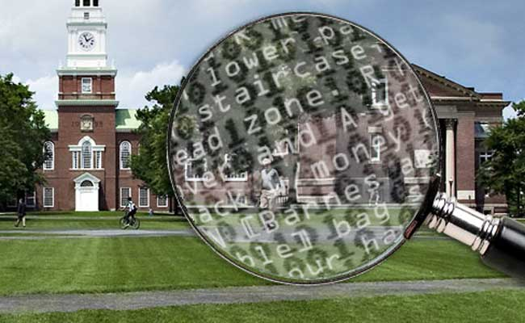
Hiding data on the network in case of a breach.
Peer-to-peer private communications.
Posting secret communications on the Web to avoidtransmission.
Embedding corrective audio or image data in case corrosionoccurs from a poor connection or transmission.
The possible use of Steganography technique is as following:

Slide 19
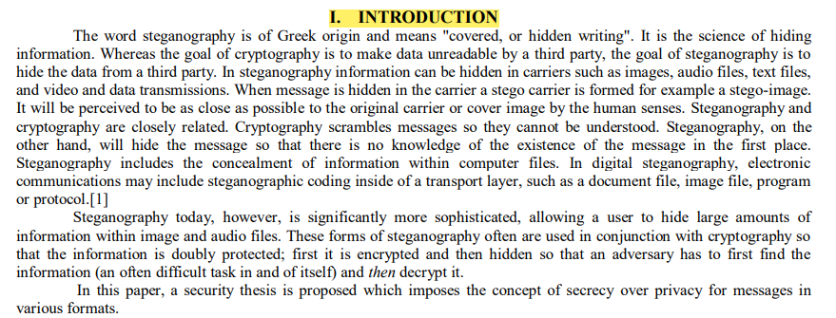
SNIPS FROM RESEARCH PAPER STEGANOGRAPHY AND ITS APPLICATIONS IN SECURITY.
PAPER BY Ronak Doshi, 1 Pratik Jain, 2 Lalit Gupta3 1, 2,3
Department of Electronics and telecommunication, Pune University, India

Slide 20
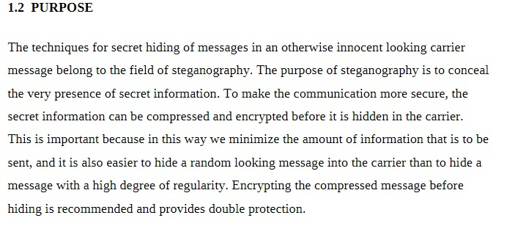
PAPER BY Ronak Doshi, 1 Pratik Jain, 2 Lalit Gupta3 1, 2,3
Department of Electronics and telecommunication, Pune University, India

Slide 21
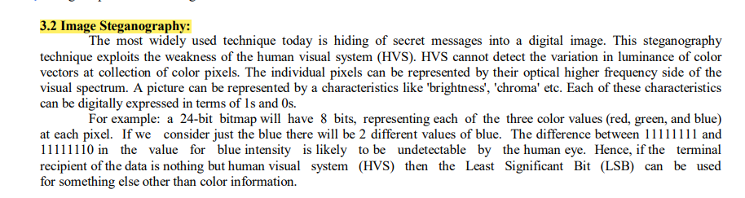
There are four ways to implement steganography:
1. Using text.
2. Using images.
3. Using audio files.
4. Using video files.[2]
PAPER BY Ronak Doshi, 1 Pratik Jain, 2 Lalit Gupta3 1, 2,3
Department of Electronics and telecommunication, Pune University, India

Slide 22
IV. STEGANALYSIS
The art of detecting Steganography is referred to as Steganalysis. Steganalysis is the process of identifying steganography by inspecting various parameter of a stego media. The primary step of this process is to identify a suspected stego media. After that steganalysis process determines whether that media contains hidden message or not and then try to recover the message from it.
In the case of Visual detection steganalysis technique, a set of stego images are compared with original cover images and note the visible difference.
Signature of the hidden message can be derived by comparing numerous images.
Cropping or padding of image also is a visual clue of hidden message because some stego tool is cropping or padding blank spaces to fit the stego image into fixed size. Difference in file size between cover image and stego images, increase or decrease of unique colors in stego images can also be used in the Visual Detection steganalysis technique.
Scientists and researchers are trying new methods to try and discover ways of detecting hidden files and rendering them useless.
The U. S. Government has contracted Wetstone Technologies to work with the U.S. Air Force to research algorithms that can be used to discover embedded files in digital, audio and video format.
Steganalysis is the technique to detect steganography or defeat steganography. The research to device strong steganographic and steganalysis technique is a continuous process.
PAPER BY Ronak Doshi, 1 Pratik Jain, 2 Lalit Gupta3 1, 2,3
Department of Electronics and telecommunication, Pune University, India

Slide 23
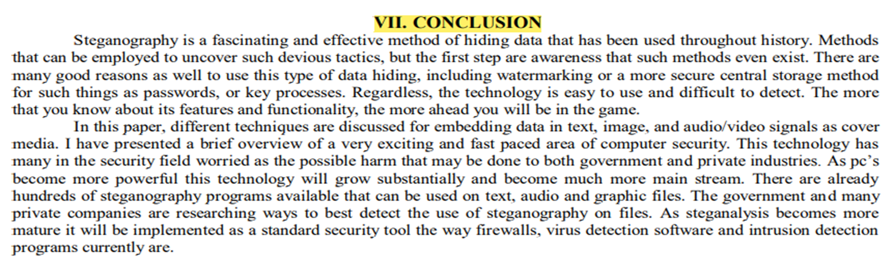
PAPER BY Ronak Doshi, 1 Pratik Jain, 2 Lalit Gupta3 1, 2,3Department of Electronics and telecommunication, Pune University, India

Slide 24
APPLICATIONS IN THE REAL WORLD
Steganography can be used anytime you want to hide data. There are many reasons to hide data but they all boil down to the desire to prevent unauthorized persons from becoming aware of the existence of a message.
In the business world steganography can be used to hide a secret chemical formula or plans for a new invention.
Terrorists can also use steganography to keep their communications secret and to coordinate attacks.
Most of the newer applications use steganography like a watermark, to protect a copyright on information. Photo collections, sold on CD, often have hidden messages in the photos which allow detection of unauthorized use. The same technique applied to DVDs is even more effective, since the industry builds DVD recorders to detect and disallow copying of protected DVDs.

Slide 25
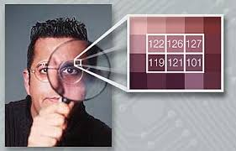
Usage in modern printer.
It is used in digital watermarking-
It can be used for digitial watermarking,where a message(being simply an identifier) is hidden in an image so that its source can be tracked or verified.
It is used for finger printing for detection of unauthorized user and illegally copied material.
It is used to maintain the confidentiality of valuable information.
It is used for protecting the data from unauthorised users.

Slide 26

Steganography, Though is still a fairly new idea. There are constant advancements in the computer field.
It is likely that there will soon be more efficient and more advanced techniques for steganalysis.
A hopeful advancement is the improved sensitivity to small message. Knowing how difficult it is to detect the presence of a fairly large text file within an image, imagine how difficult it is to detect even one or two sentences embedded in image.
In the future, it is hoped that the technique of steganalysis will advance such that it will become much easier to detect even small messages within an image.

Slide 27
What we learnt !
With this project we have learned a lot, especially about bit operations. This project was fun from the start and only got more interesting we went on developing it. we became more interested in the subject when researching it. We have learned that while implementing Image steganography it is important ,thinking of how to detect and attack it ,and the methods to do so are far more complex than actually doing the steganography itself. There is a lot of research that is beginning to discover new ways to detect Steganography. It is interesting to see how methods will be developed and how accurate they will be detecting Steganography.

Slide 28


